Slide 1
Advanced NLP
Commonsense Learning and Reasoning
Michihiro Yasunaga
09-20-2018

Slide 2
Outline
Introduction & Background
Motivation
Tasks: traditional and recent
Presentation of paper 1,2 --- Physical commonsense
Presentation of paper 3 --- Social commonsense
Presentation of paper 4 --- Narrative commonsense
Summary & Future directions
Discussion questions
Reference

Slide 3
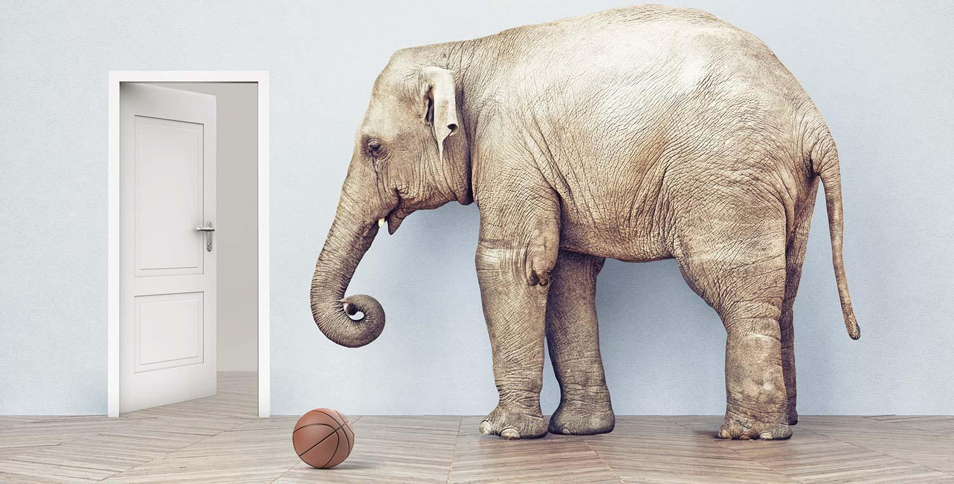
What is commonsense?
Common knowledge about things in the world, their associations, and interactions.
A ball and an elephant, which one would typically fit through a doorway?
Is ice cold or hot?
What do people usually do at a restaurant?
https://allenai.org/commonsense/

Slide 4
Why need commonsense?
Intelligent natural language understanding
Language is contextual.
Need to read between lines using world knowledge, discourse, etc.

Slide 5
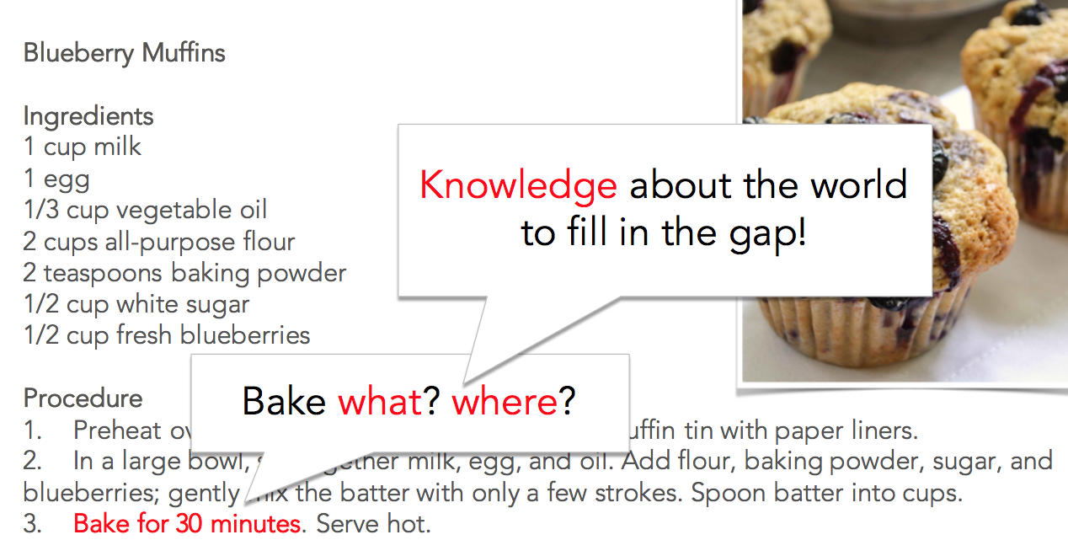
Why need commonsense?
Difficult problem in AI
AI still doesn’t have commonsense
Natural language understanding
Language is contextual
Need to read between lines
Robotics
https://www.slideshare.net/aclanthology/yejin-choi-2017-from-naive-physics-to-connotation-modeling-commonsense-in-frame-semantics

Slide 6
Why need commonsense?
Intelligent natural language understanding
Language is contextual.
Need to read between lines using world knowledge, discourse, etc.
Robotics & Vision
Visual and spatial understanding

Slide 7
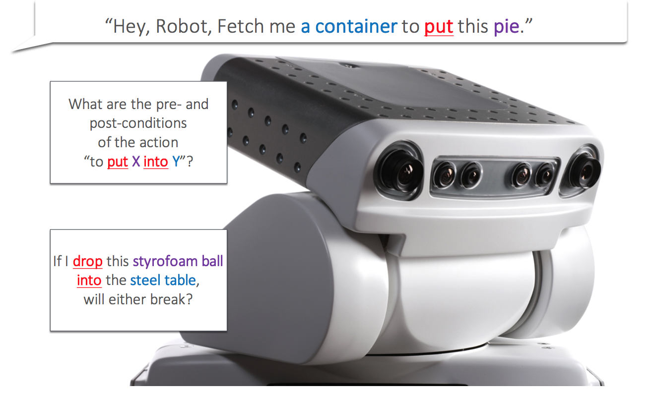
Why need commonsense?
https://www.slideshare.net/aclanthology/yejin-choi-2017-from-naive-physics-to-connotation-modeling-commonsense-in-frame-semantics

Slide 8
Why need commonsense?
Intelligent natural language understanding
Language is contextual.
Need to read between lines using world knowledge, discourse, etc.
Robotics & Vision
Visual and spatial understanding
This talk focuses on commonsense learning & reasoning using NLP

Slide 9
Commonsense AI is hard
Commonsense is trivial for humans but remarkably hard for machines
Challenges:
implicit and sparse, due to reporting bias (humans tend not to explicitly state the obvious) ⇒ hard to learn automatically
multimodal, as it is spread across textual and visual sources,
context dependent (often in narrative settings)
Commonsense AI was studied a lot in 80-90’s
But then not explored for a while until the last few years
(almost no papers about commonsense during 2000-2010 in ACL Anthology)

Slide 10
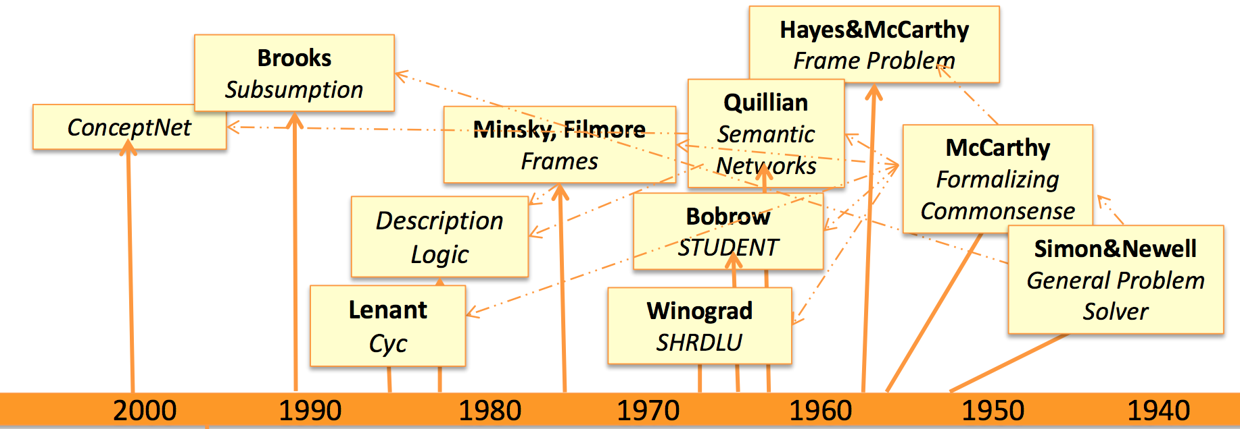
History
https://www.microsoft.com/en-us/research/wp-content/uploads/2016/06/Roth-Dan_CS-NLU.pdf

Slide 11
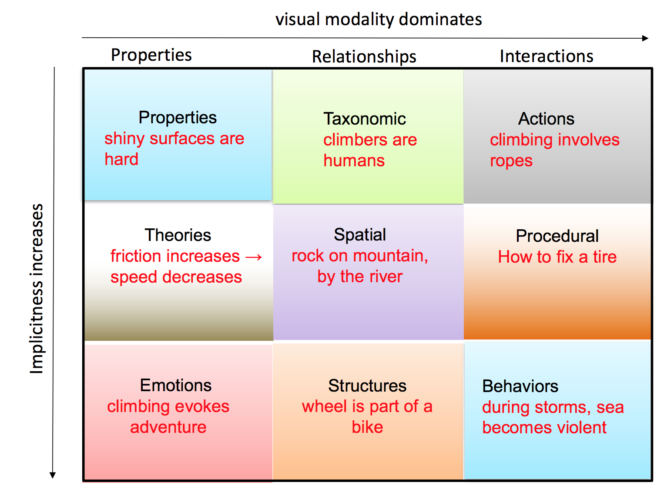
Types of commonsense
Traditional tasks:
Knowledge base
Taxonomic
From [Melo et al., 2017]

Slide 12
Types of commonsense
Harder to learn automatically
Physical commonsense
Properties, spatial, actions
Social commonsense
Minds, emotions, behaviors
Story understanding
Narrative commonsense
Apply commonsense for inference/reasoning
From [Melo et al., 2017]

Slide 13
Examples
There are many different types of commonsense. Here are a few examples:
Physical commonsense (properties, spatial)
E.g. “The trophy doesn’t fit in the suitcase because it is too big”
Social commonsense (minds, emotions, behaviors)
E.g. “Person X reads Person Y's diary”
X’s intent: curious
X’s reaction: feel guilty. Y’s reaction: feel betrayed
Narrative understanding
E.g. “Mary went to a restaurant” ⇒ we expect “she ordered foods”, or “she slept”?

Slide 14
Commonsense knowledge bases
Cyc Project (1995-)
ConceptNet (2004-)
DBpedia (2007-)
YAGO (2008-)
Google knowledge graph (previously, Freebase)
Some attempted to collect not only encyclopedic knowledge but also implicit one in everyday life

Slide 15
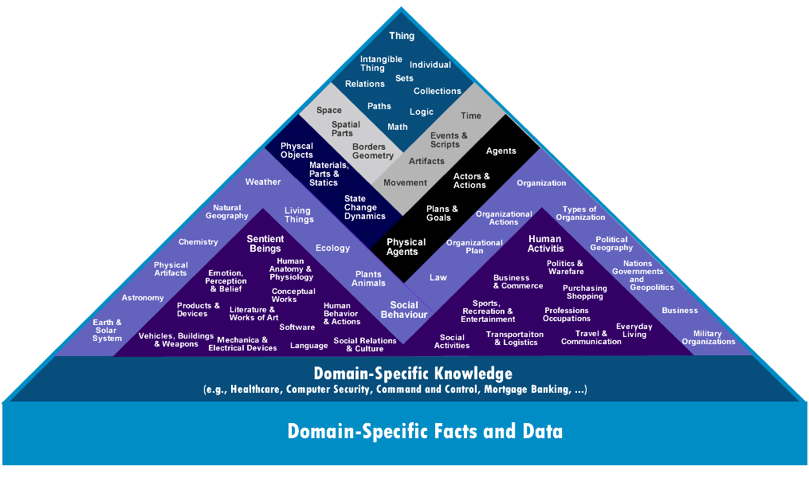
Cyc & OpenCyc project [Lenat 1995]
“World's longest-lived artificial intelligence project, attempting to assemble a comprehensive ontology and knowledge base that spans the basic concepts and "rules of thumb" about how the world works”
Web: www.cyc.com/
Wiki: en.wikipedia.org/wiki/Cyc
OpenCyc is an open source
version of Cyc
http://www.cyc.com/wp-content/uploads/2015/04/kbase.png

Slide 16
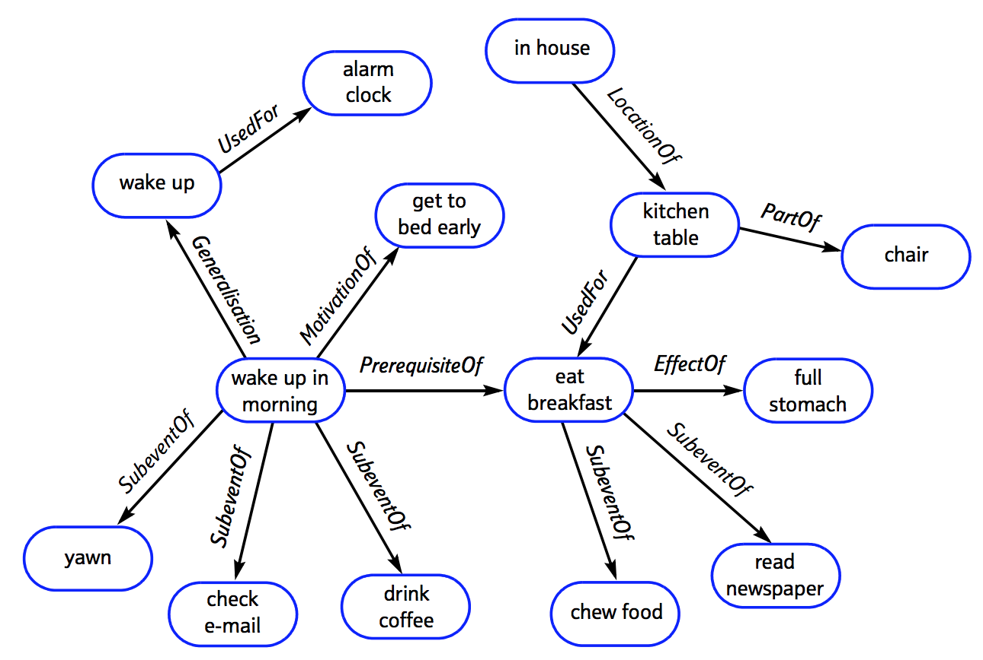
ConceptNet [Liu et al., 2004]
Knowledge graph. Crowd-sourced.
Over 1.6 million assertions of commonsense knowledge about
“spatial, physical, social, temporal, and psychological aspects of everyday life.”
Freely available at conceptnet.io
Keeps expanding:
ConceptNet 5: 2012
ConceptNet 5.5: 2016
http://alumni.media.mit.edu/~hugo/publications/papers/BTTJ-ConceptNet.pdf
Notes:
Implicite knowledge

Slide 17
Recent trends
Can we develop machine learning algorithms to automatically learn commonsense knowledge?
Physical commonsense [Forbes & Choi, 2017] [Yang et al., 2018] [Gao et al., 2018]
Properties, spatial, actions
Social commonsense [Rashkin et al., 2018a] [Rashkin et al., 2018b]
Minds, emotions, behaviors
How to use commonsense knowledge to reason about natural language?
Story understanding [Mostafazadeh et al., 2016] [Lin et al., 2017]
Narrative commonsense

Slide 18
Papers Covered Today
Physical commonsense:
Verb Physics: Relative Physical Knowledge of Actions and Objects, 2017
What Action Causes This? Towards Naive Physical Action-Effect Prediction, 2018
Social commonsense:
Event2Mind: Commonsense Inference on Events, Intents, and Reactions, 2018
Story understanding:
Reasoning with Heterogeneous Knowledge for Commonsense Machine Comprehension, 2017

Slide 19
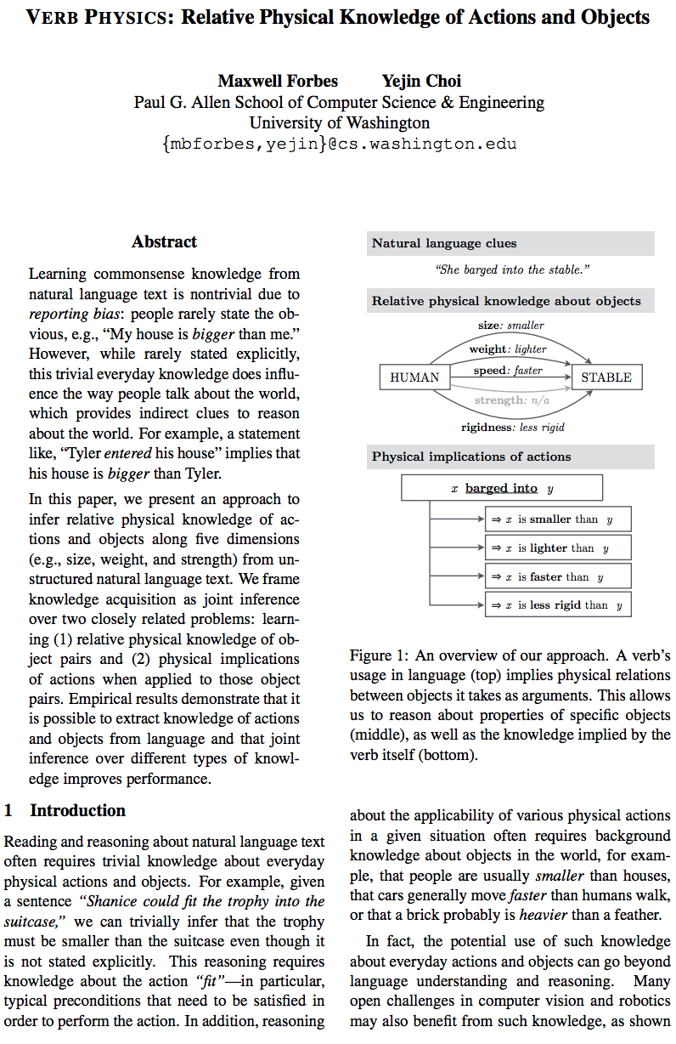
Paper 1: Verb Physics
Verb Physics: Relative Physical Knowledge of Actions and Objects
Maxwell Forbes and Yejin Choi (ACL 2017)
“In this paper, we present an approach to infer relative physical knowledge of actions and objects along five dimensions (e.g., size, weight, and strength) from unstructured natural language text. We frame knowledge acquisition as joint inference over two closely related problems: learning (1) relative physical knowledge of object pairs and (2) physical implications of actions when applied to those object pairs. Empirical results demonstrate that it is possible to extract knowledge of actions and objects from language and that joint inference over different types of knowledge improves performance.”

Slide 20
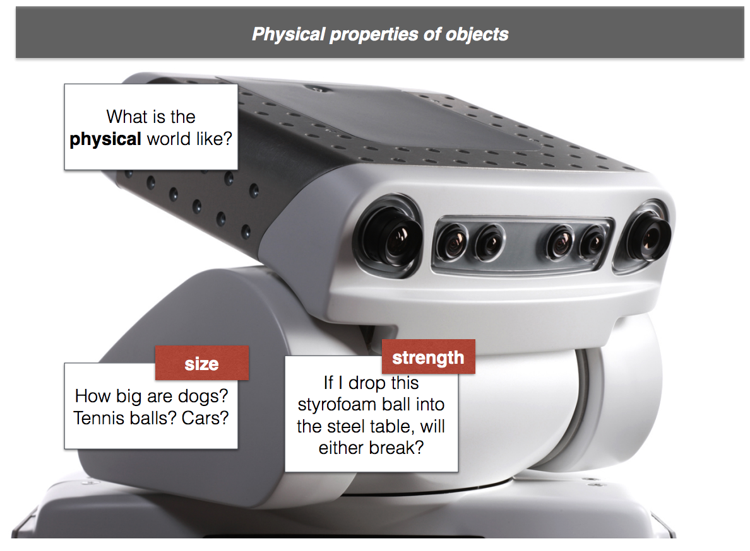
Motivation
Want to learn physical properties of objects like:
Size
Weight
Strength
Rigidness
Speed
http://maxwellforbes.com/data/research/publications/forbes2017verb/slides.pdf

Slide 21
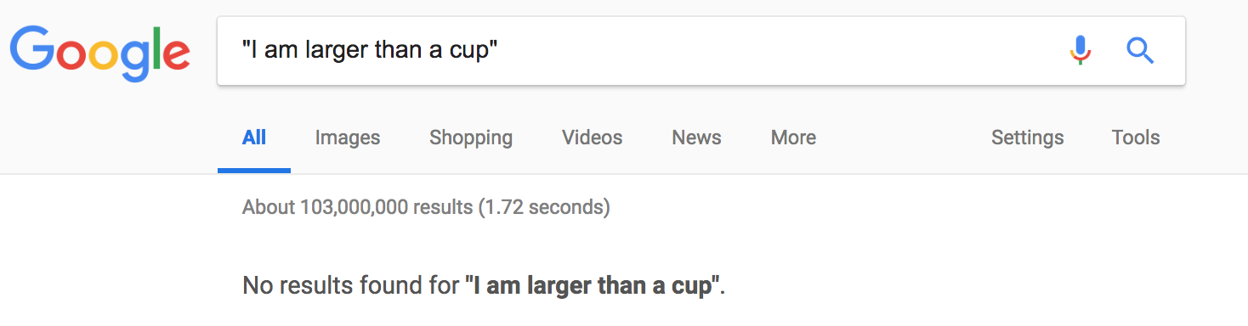
Motivation
Challenge: people don’t state the obvious. [Grice 1975]
"I am larger than a cup", "human is larger than a ball"
⇒ how to overcome reporting bias?
As of 2018-09-09

Slide 22
Motivation
Computer vision-based approaches can learn size, but cannot learn diverse aspects like weight, strength, speed.
⇒ Back to language.
Automated algorithm to learn physical relations from unstructured text, while overcoming reporting bias?

Slide 23
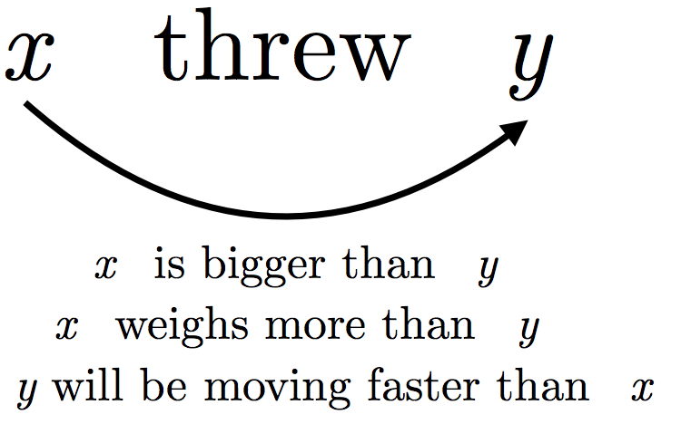
Idea
Automated algorithm to learn physical relations from unstructured text
How to overcome reporting bias?
⇒ Look at verbs.
Action verbs reveal object
relationships
http://maxwellforbes.com/data/research/publications/forbes2017verb/slides.pdf

Slide 24
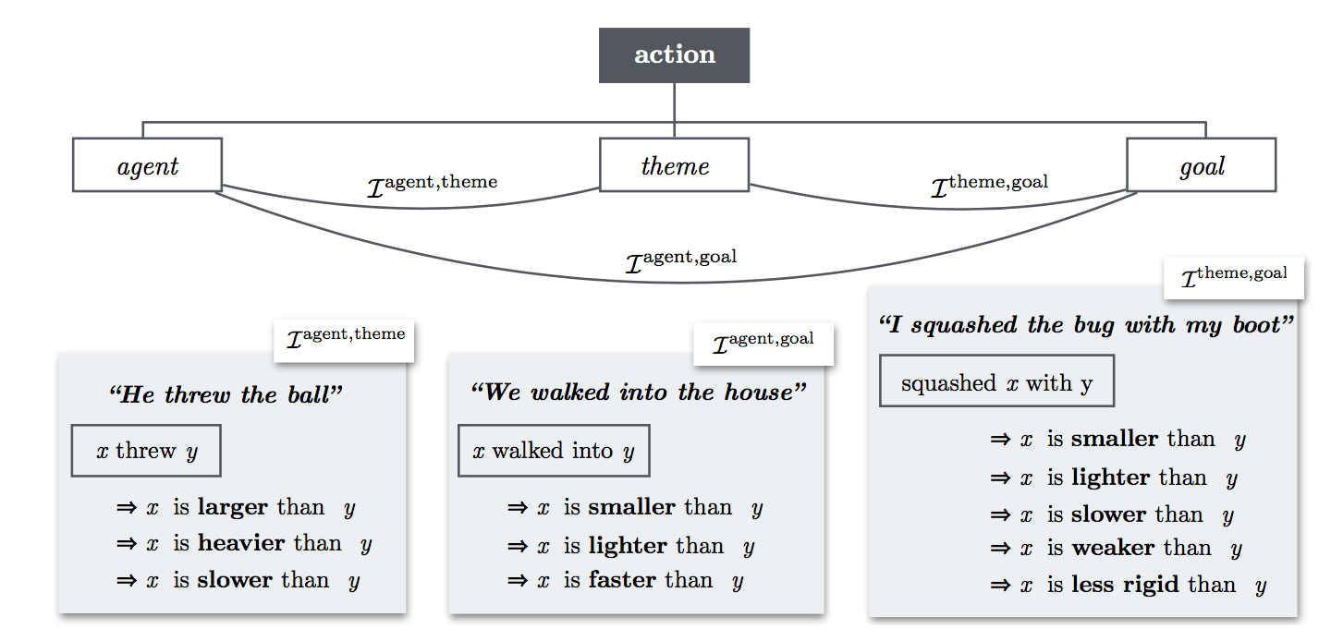
Verb frames and implications

Slide 25
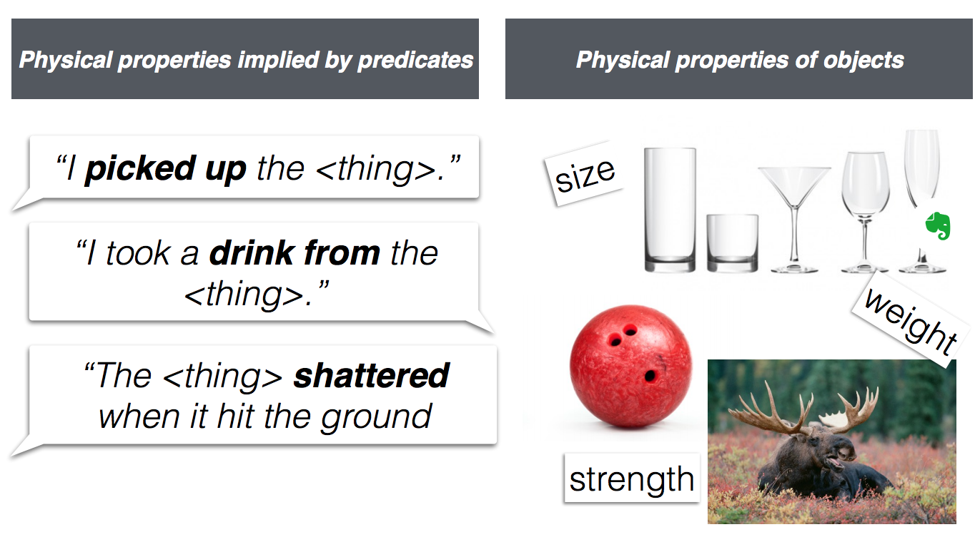
Jointly solve two problems
“Original”: physical properties of objects, such as
person >^{size} ball
“Dual”: what physical properties predicates imply, such as
x picked up y ⇒ x >^{size} y
http://maxwellforbes.com/data/research/publications/forbes2017verb/slides.pdf

Slide 26
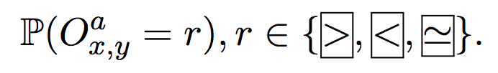
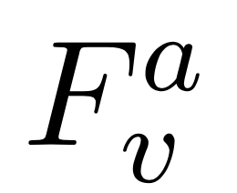
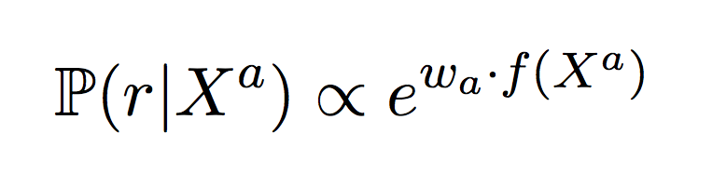
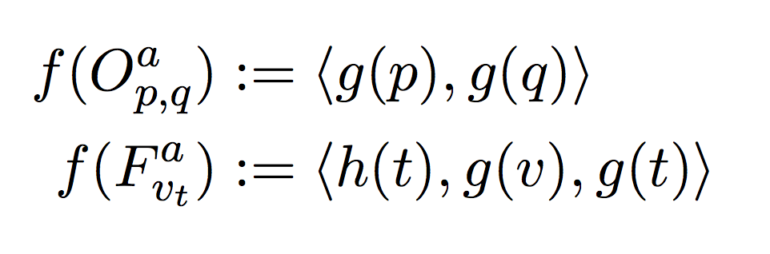
Formally...
a can be {size, weight, ...}
Random variable for object pair (x, y), along property a:
Random variable for verb frame v, along property a:
Want to learn these probability distributions!
Parametrization:
w_{a} is the weight to learn for each property
Basically, function of word embeddings

Slide 27
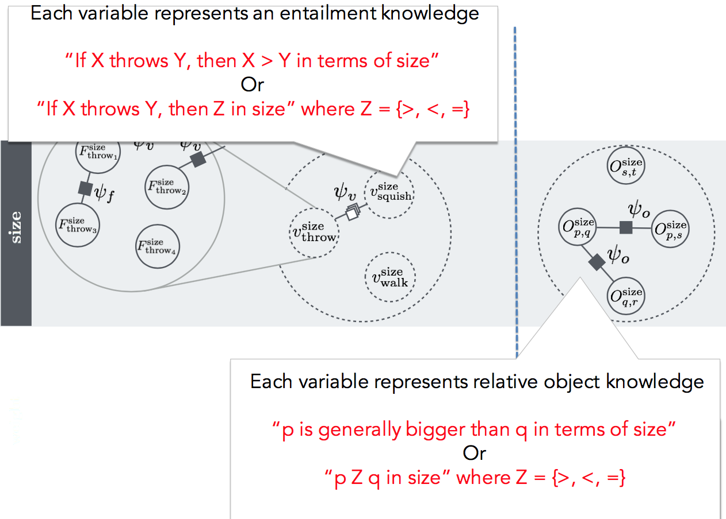
Model
We cannot directly observe the values of those random variables from text, due to reporting bias
BUT...
https://www.slideshare.net/aclanthology/yejin-choi-2017-from-naive-physics-to-connotation-modeling-commonsense-in-frame-semantics

Slide 28
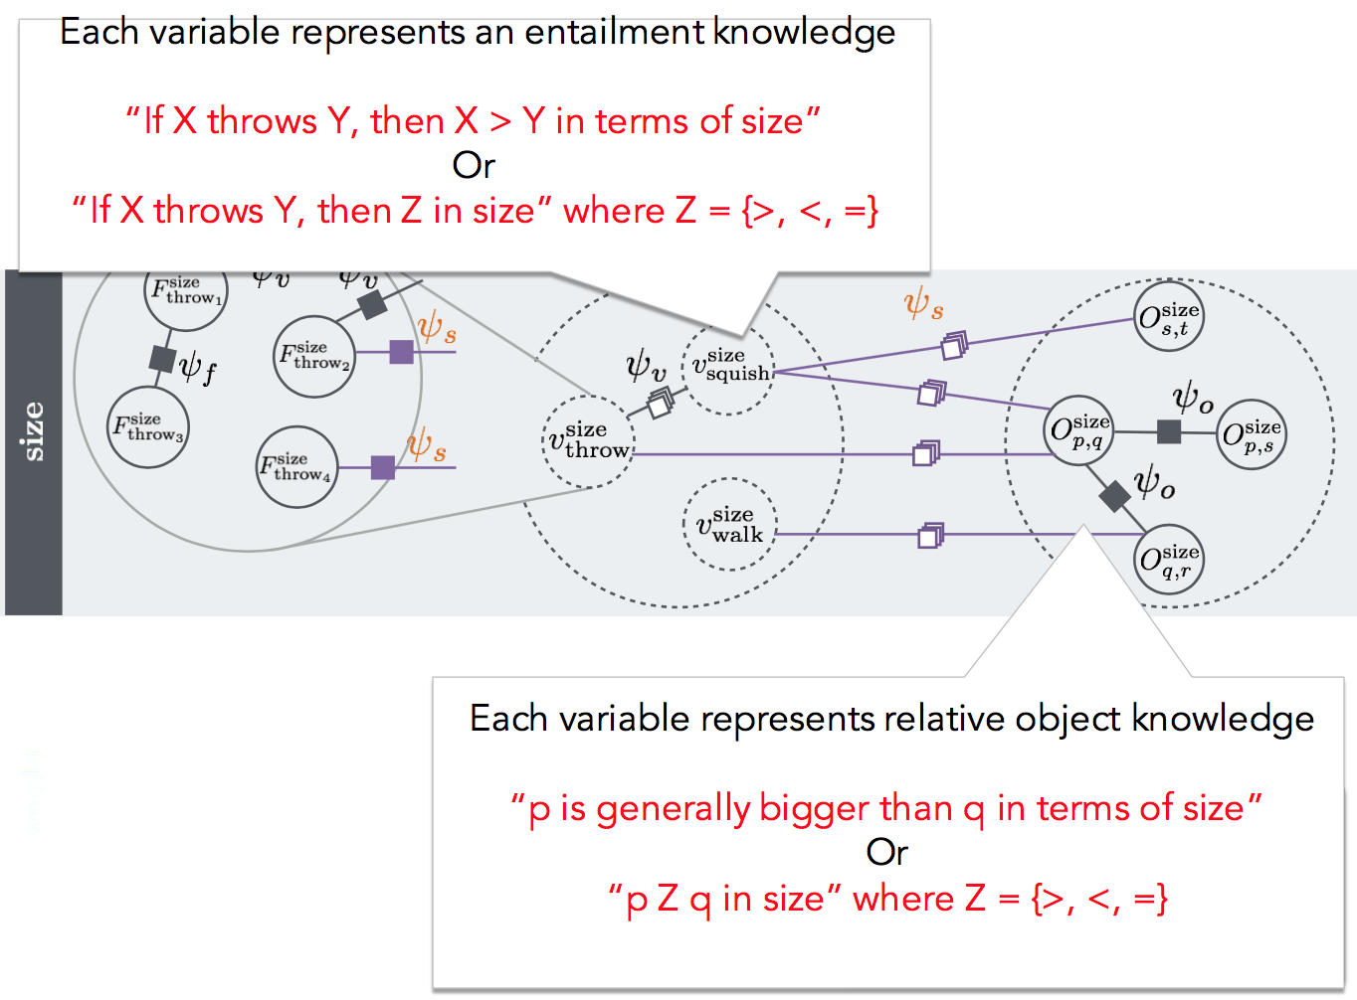
Model
Give seed knowledge for some of the
and
=> Belief propagation to learn the distribution for all the random variables.
https://www.slideshare.net/aclanthology/yejin-choi-2017-from-naive-physics-to-connotation-modeling-commonsense-in-frame-semantics

Slide 29
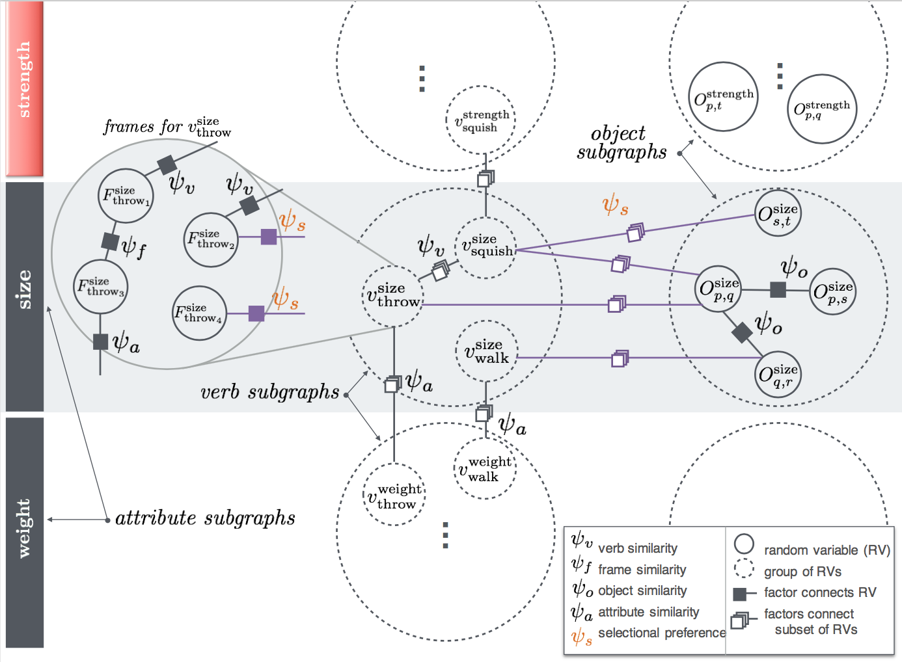
Model
An edge encourages two nodes to have the same value
https://www.slideshare.net/aclanthology/yejin-choi-2017-from-naive-physics-to-connotation-modeling-commonsense-in-frame-semantics

Slide 30
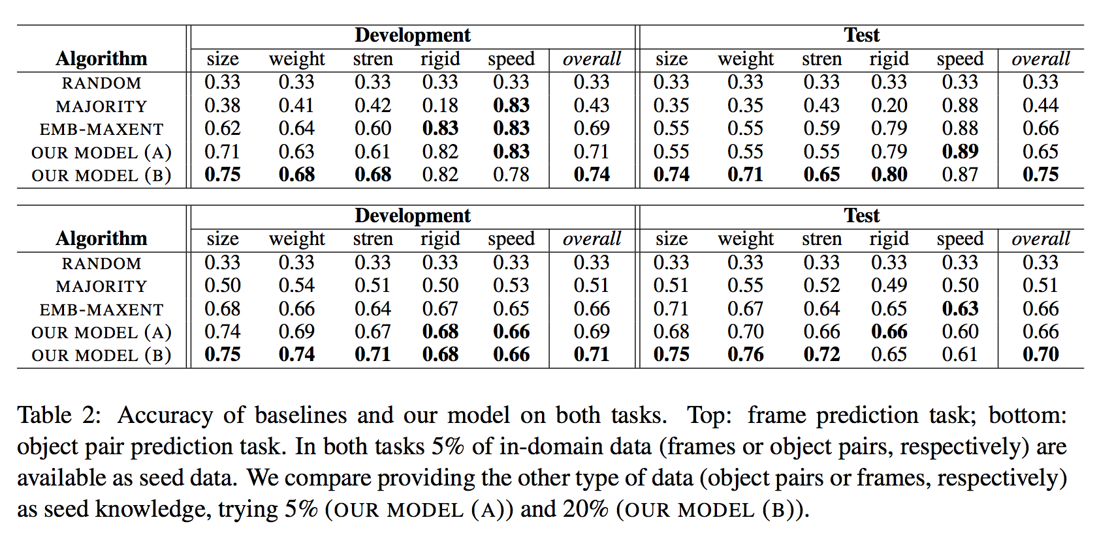
Results

Slide 31
Error analysis & Remaining challenges
X caught Y
“She caught the runner in first” ⇒ she >^{speed} runner
“She caught the baseball” ⇒ she <^{speed} baseball
Multiple usages of the same verb
PERSON stopped X with Y
“He stopped a fly with a jar” ⇒ fly <^{weight} jar
“She stopped the car with the brake” ⇒ car >^{weight} brake
Underlying complex physics
(examples from the paper)

Slide 32
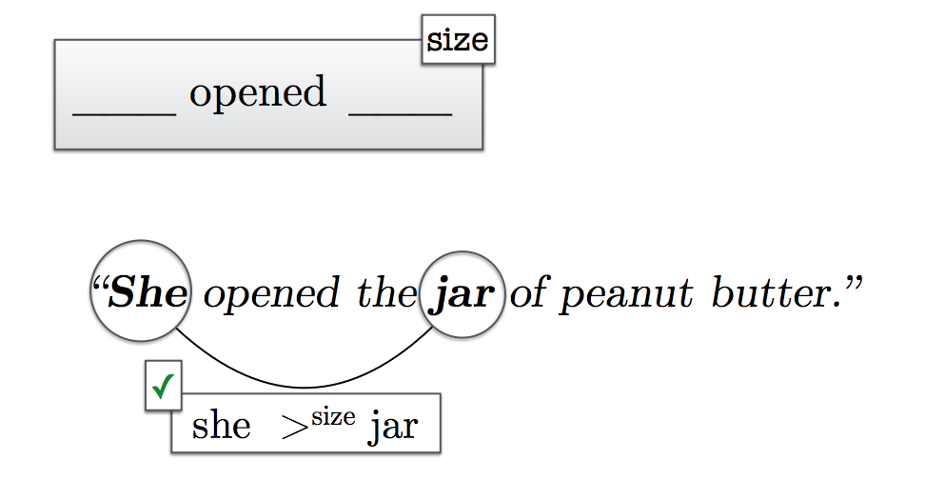
Result & Takeaway
It is possible to design a model or inference algorithm that can reason about unspoken knowledge, drawing the clue from how people use the language.

Slide 33
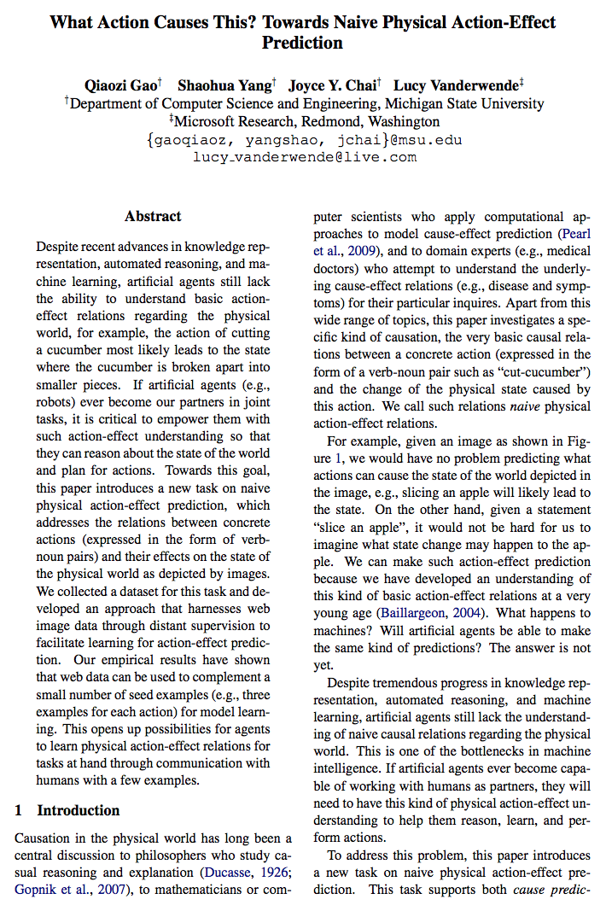
Paper 2: Action-Effect
What Action Causes This? Towards Naive Physical Action-Effect Prediction
Qiaozi Gao, Shaohua Yang, Joyce Chai, Lucy Vanderwende (ACL 2018)
“this paper introduces a new task on naive physical action-effect prediction, which addresses the relations between concrete actions (expressed in the form of verb- noun pairs) and their effects on the state of the physical world as depicted by images. Our empirical results have shown that web data can be used to complement a small number of seed examples (e.g., three examples for each action) for model learning.”

Slide 34
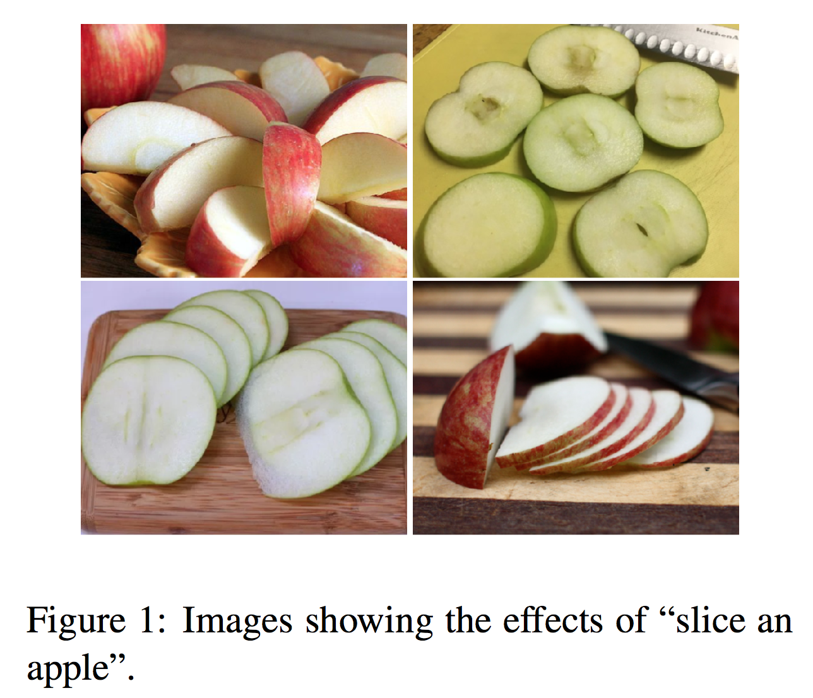
Motivation
Want to learn action-effect knowledge like “splice an apple” (action) ⇒ “divided into smaller pieces” (physical state change)
Such knowledge is not collected in existing knowledge base like YAGO, Freebase
But can be useful for robots to reason about the state of the world and plan for actions.

Slide 35
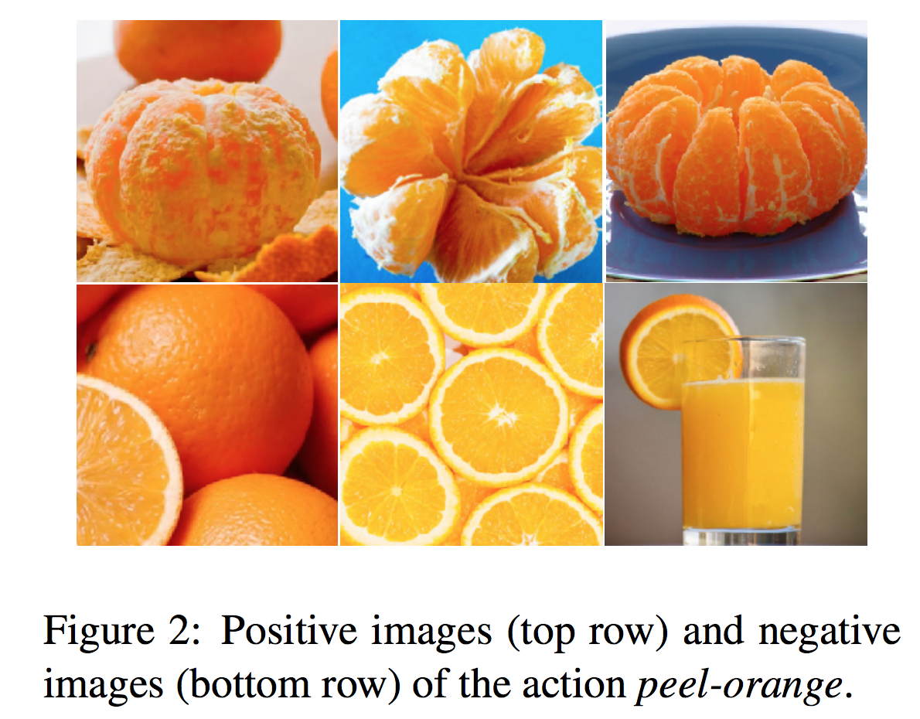
Data collection
Actions (verb-noun pairs):
Manually selected 140 verb-noun pairs that are concrete and appear in everyday life. E.g. “tear + book”, “wipe + window”, “peel + orange”
Effect Description in Language (1400 per action)
“The book is ripped”
“The window would begin to get clean”
“The orange is divided slices”
Effects Depicted in Images
Manually collect 5 positive / 5 negative images

Slide 36
Task 1: Action-effect prediction using images
Given an image that depicts a state of the world, can we predict what action could have caused it?
Given an action (verb-noun), find the most likely image depicting the effect
Model sketch
Pr (action | effect image) = softmax ( CNN (image) )

Slide 37
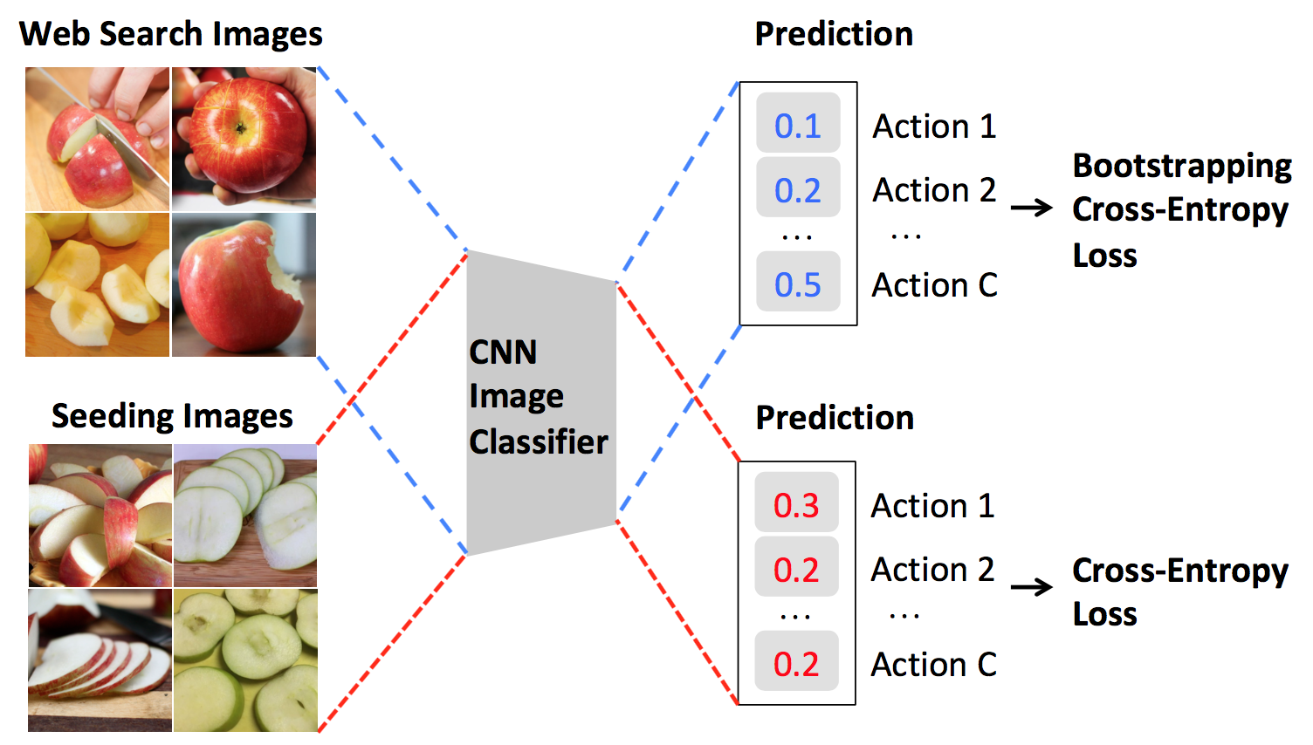
Model
The manual data is too small for training.
Add web searched images for training as bootstrapping

Slide 38
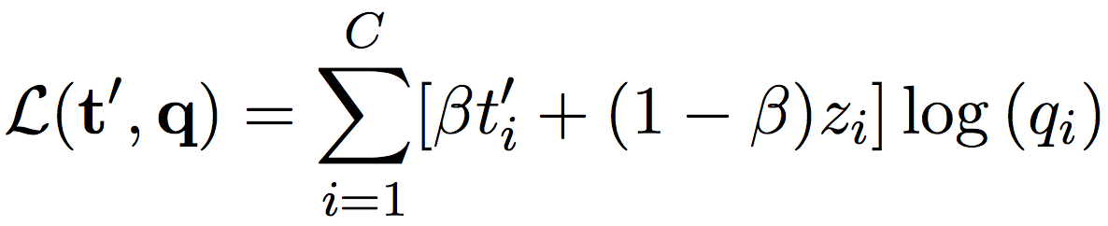
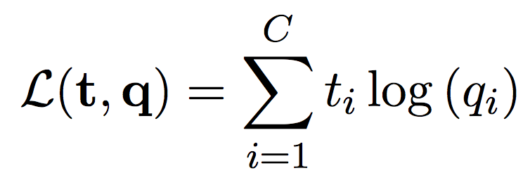
Model (bootstrapping)
Noisy label
Current model’s prediction (copy)
True label
Prediction

Slide 39
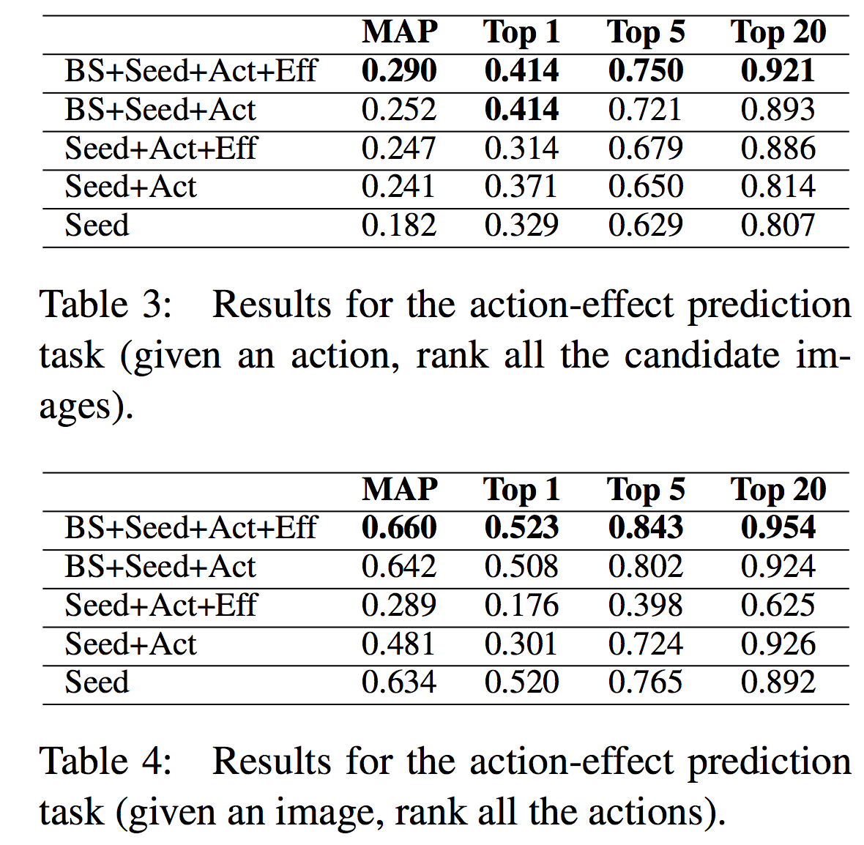
Results

Slide 40
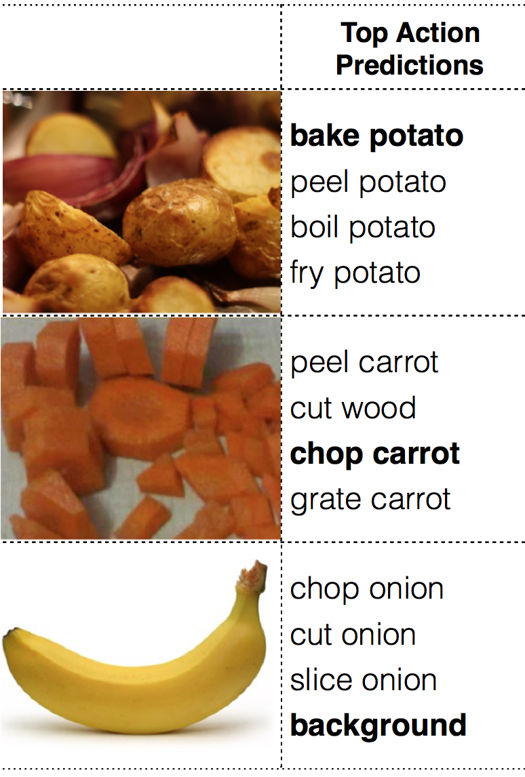
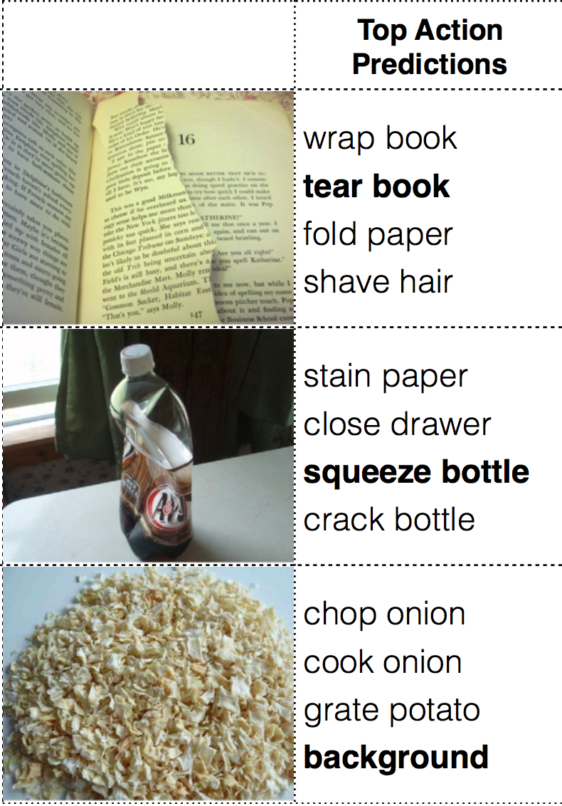
Results

Slide 41
Task 2: Action ⇒ effect prediction in language
Motivation:
In real applications, we also want to predict effect in language, but may not have the effect knowledge for every action
Can we learn and generalize like
from “cut cucumber ⇒ into pieces”
to “chop carrots ⇒ into pieces” ?
Idea
Use embedding-based models

Slide 42
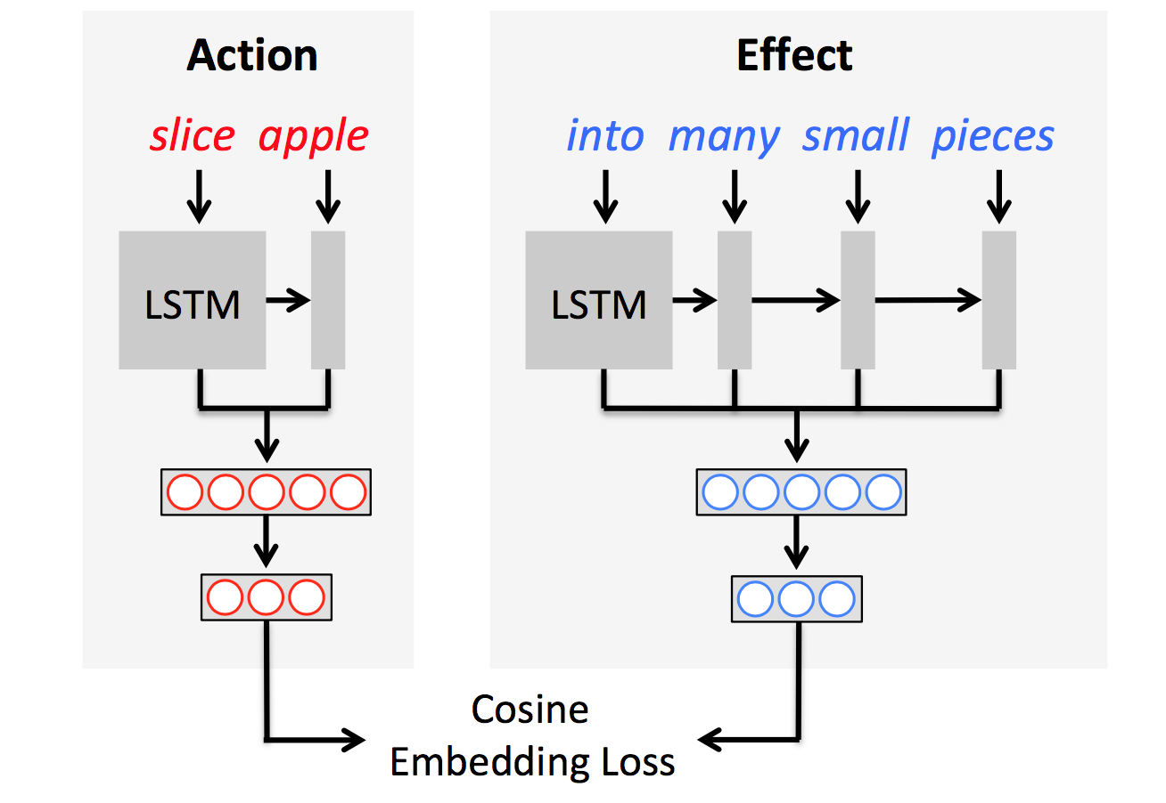
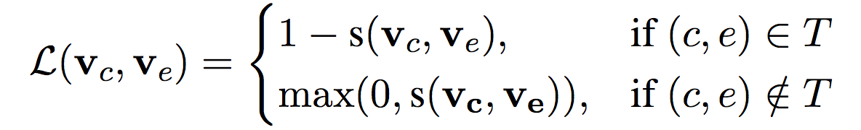
Model
Use LSTM + dense_layer to get
Action embedding
Effect embedding
Training minimizes the cosine loss below.
In testing, find the description candidate that has the closest embedding to action
(if they are actual action-effect pair)
(if not)

Slide 43
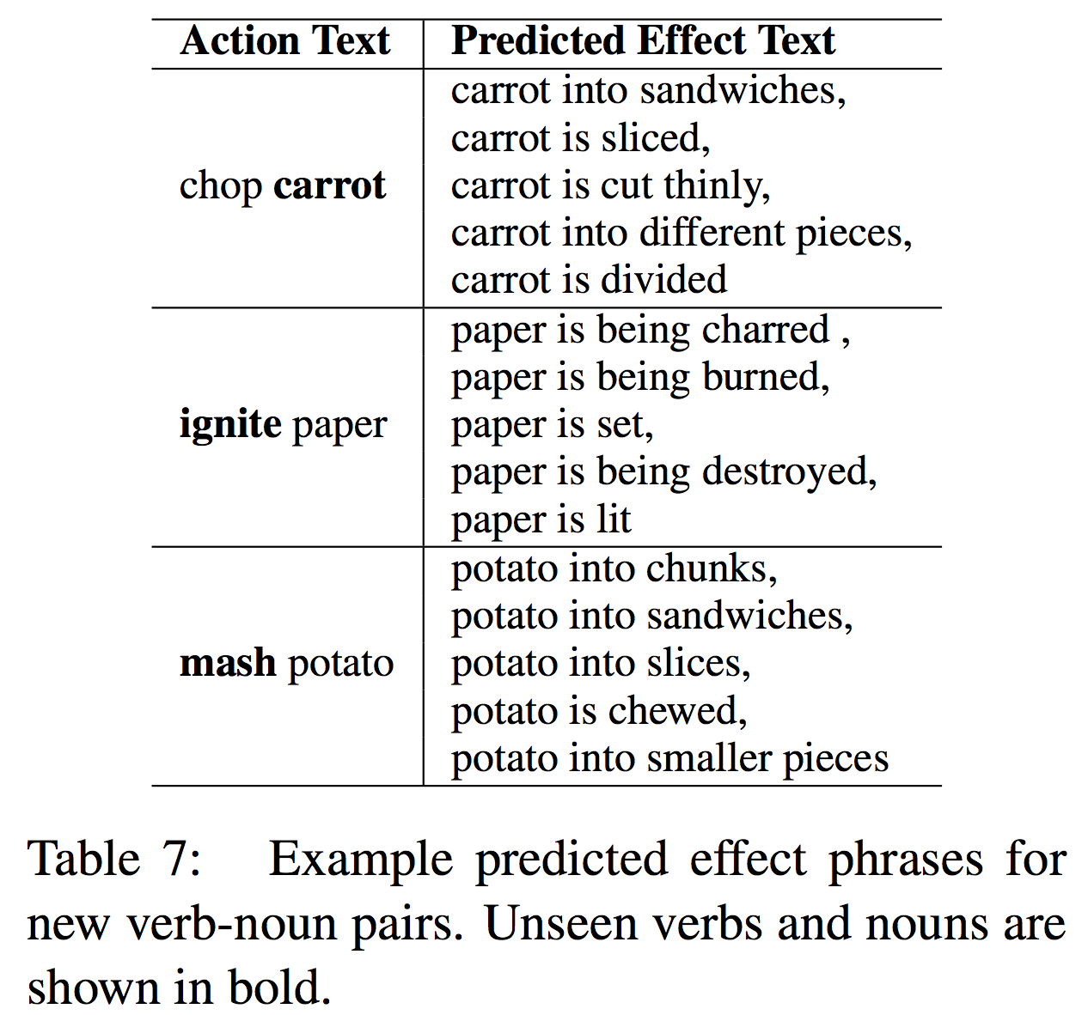
Result
Can predict effect description from unseen actions (verb-noun pairs)

Slide 44
Discussion
Some limitations:
This works for one unseen verb or noun. What about both are unseen? We need more analysis.
The model is quite simple, and performance could be further improved.
Contributions:
The action-effect task is new and very interesting! Robots eventually need to not only perceive the world but also understand actions (in both language and vision)

Slide 45
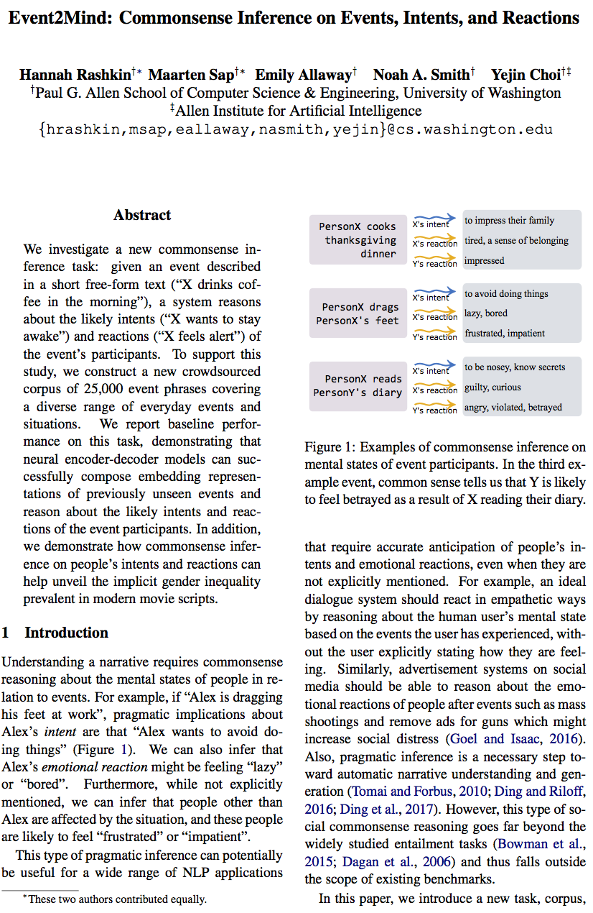
Paper 3: Social commonsense
Event2Mind: Commonsense Inference on Events, Intents, and Reactions
Hannah Rashkin, Maarten Sap, Emily Allaway, Noah A. Smith and Yejin Choi (ACL 2018)
“We investigate a new commonsense inference task: given an event described in a short free-form text (“X drinks coffee in the morning”), a system reasons about the likely intents (“X wants to stay awake”) and reactions (“X feels alert”) of the event’s participants. To support this study, we construct a new crowdsourced corpus of 25,000 event phrases covering a diverse range of everyday events and situations”

Slide 46
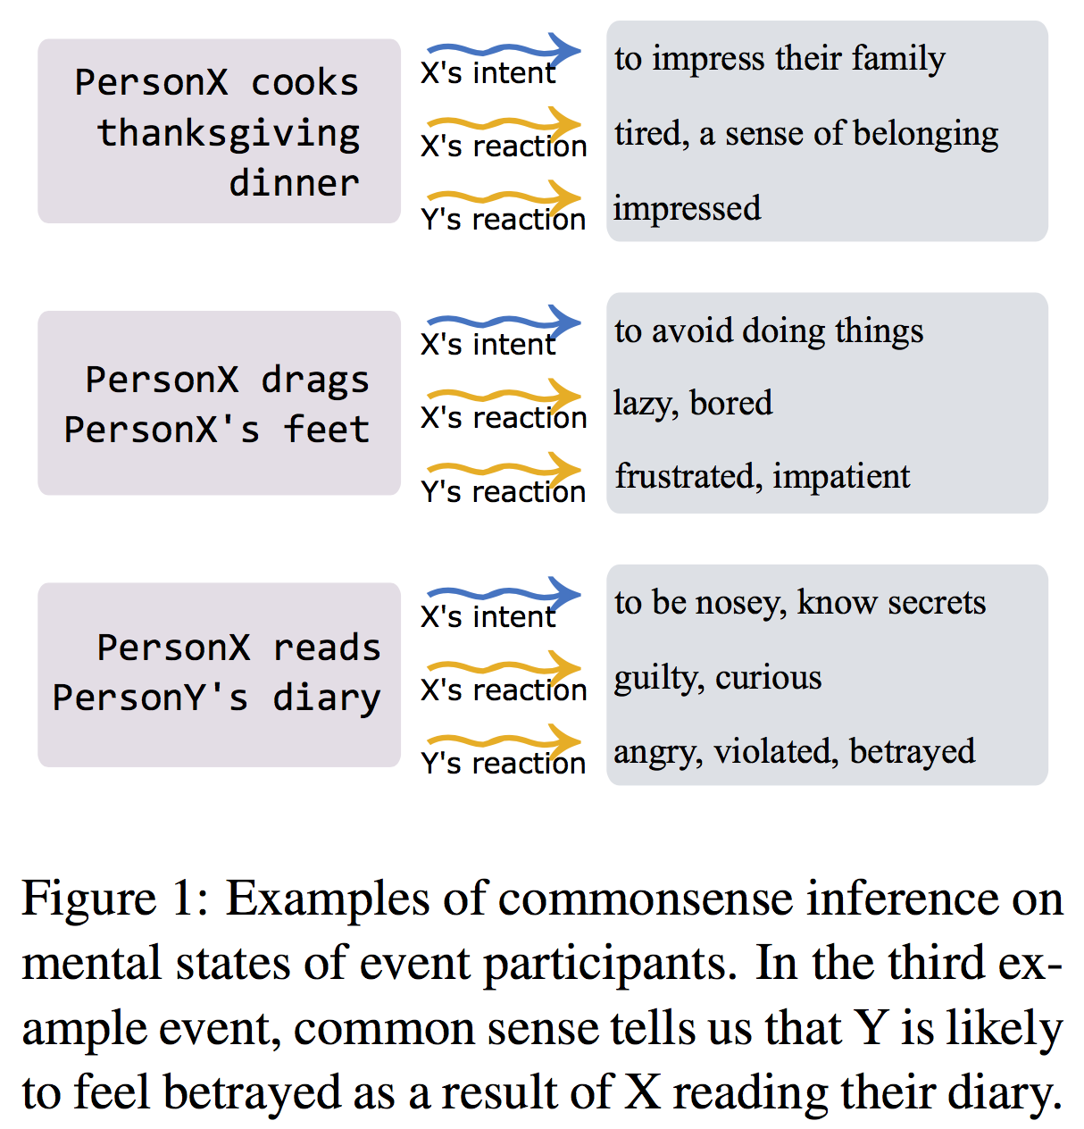
Motivation
Pragmatic knowledge and inference about human minds is necessary to
Understand a narrative
Perform dialogue in empathetic ways like humans do

Slide 47
Idea
Is it possible to build NLP models that, given an event description text, can infer people’s intent and reactions?
⇒ Collect a large dataset and train a model!

Slide 48
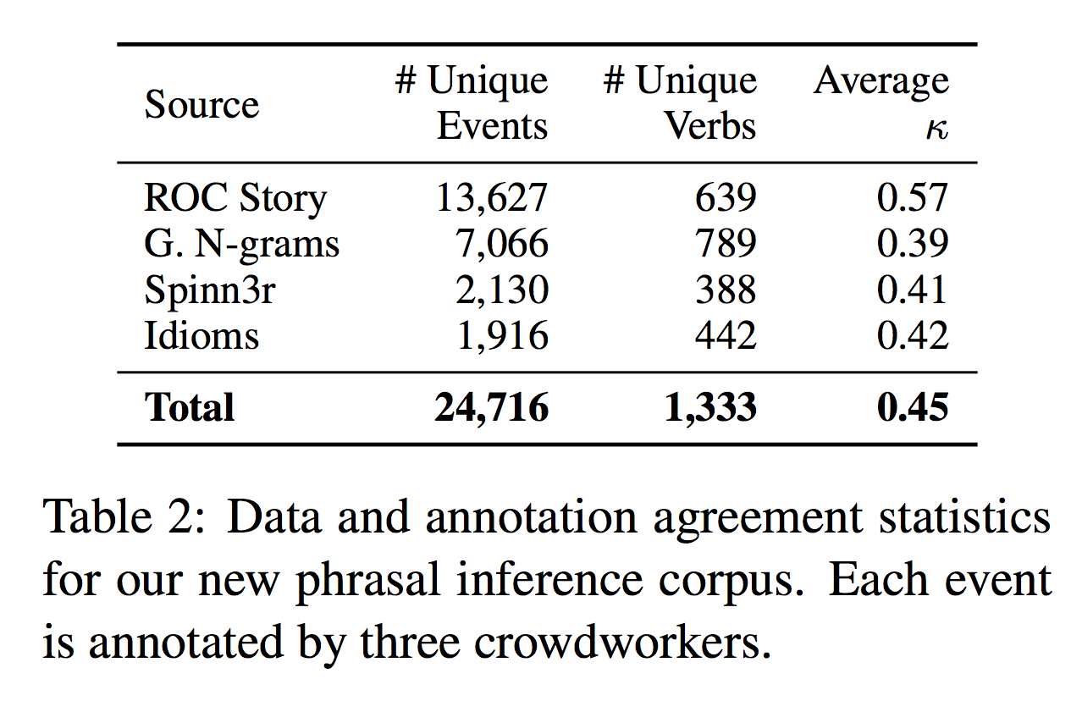
Task
Dataset: 25,000 event phrases with annotated intent and reactions
Given: text description of an event:
E.g. PersonX gives PersonY ___ as a gift
Infer pragmatics:
PersonX’s intent (for the action)
PersonX’s reaction (how the mental state changes)
PersonY’s reaction

Slide 49
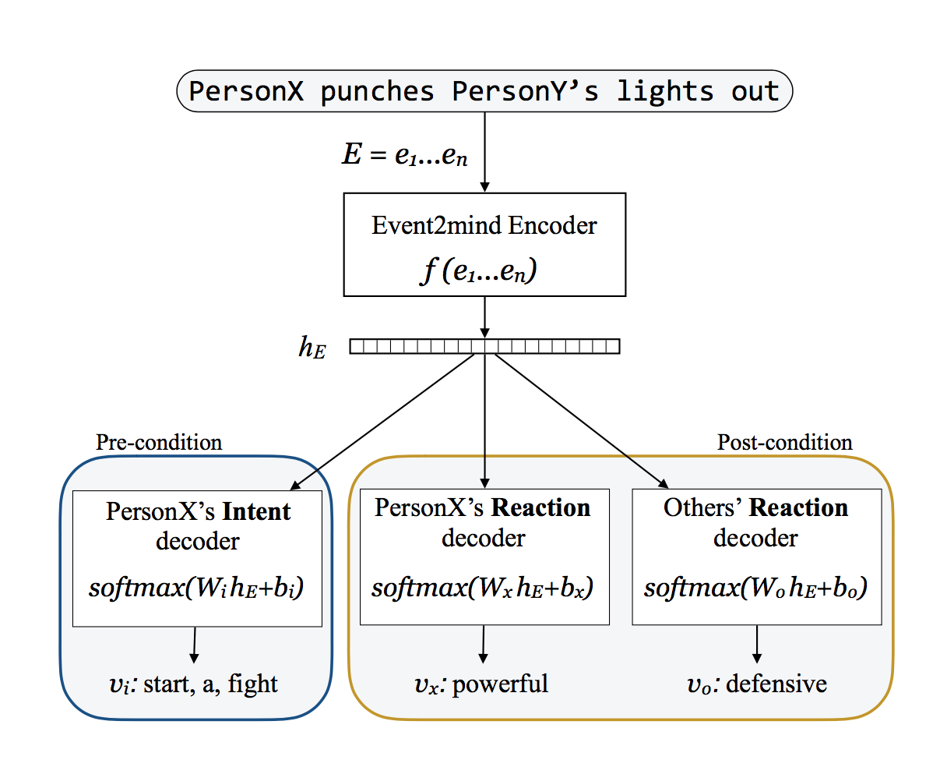
Model
Encoder-decoder model!

Slide 50
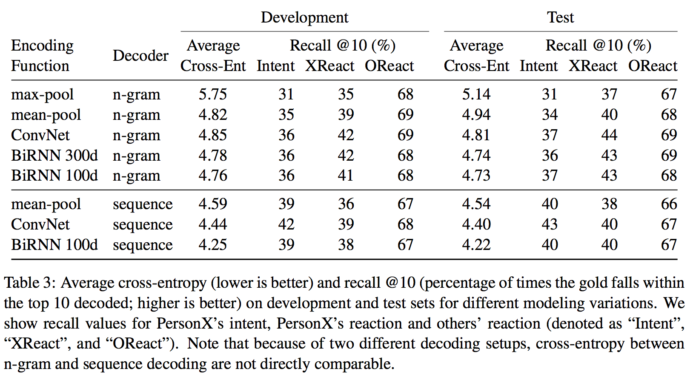
Result

Slide 51
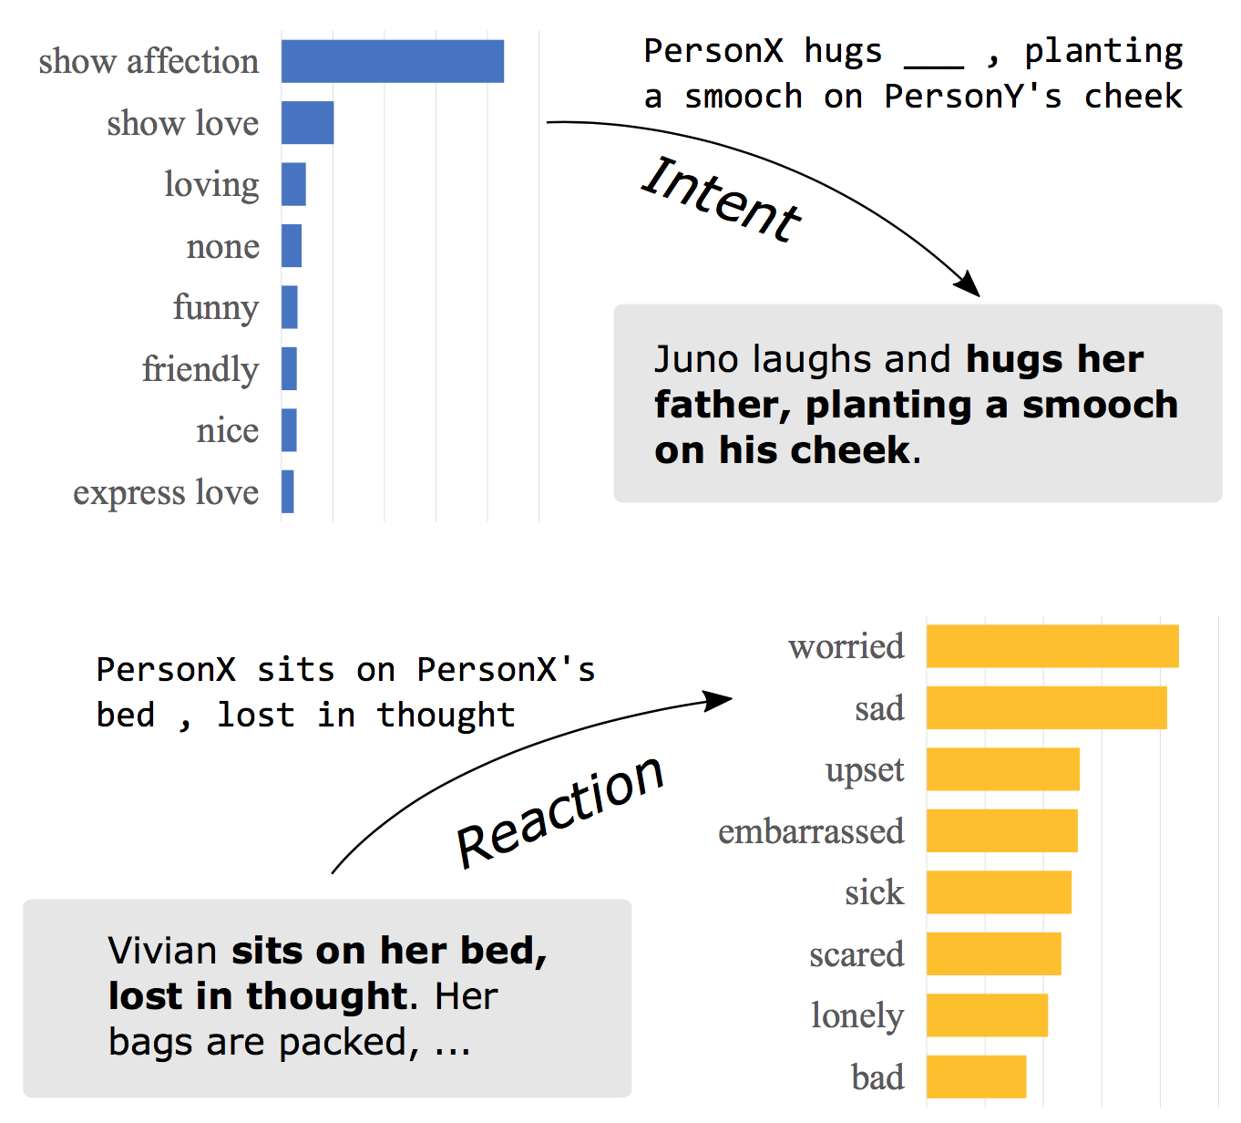
Application
Movie understanding:
Two scene description snippets from Juno (2007, top) and Pretty Woman (1990, bottom).
Shows Event2mind inferences on the characters’ intents and reactions.

Slide 52
Discussion
I think major contributions of Paper 2 (action-effect) & Paper 3 (event2mind) are their novel tasks and datasets.
The models used are relatively simple, and are initial steps for these important commonsense learning tasks.
Maybe we can think about possible improvements on their models?

Slide 53
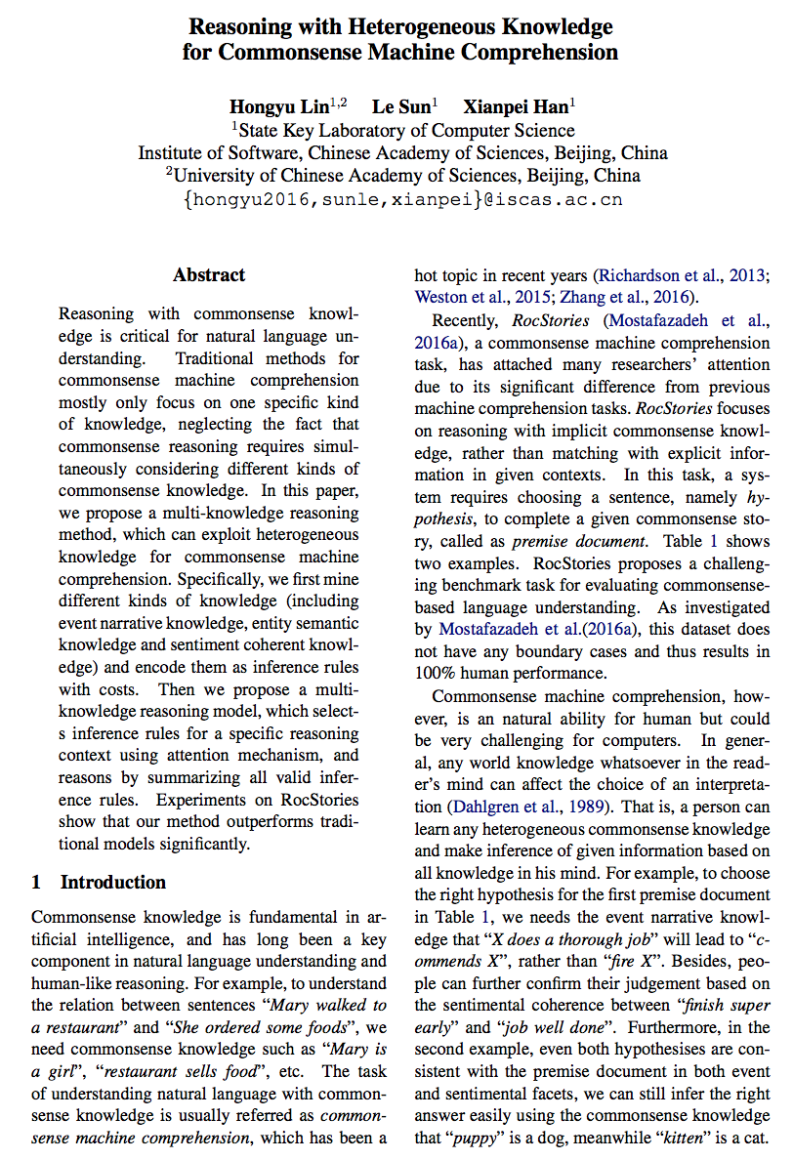
Paper 4: Commonsense for story understanding
Reasoning with Heterogeneous Knowledge for Commonsense Machine Comprehension
Hongyu Lin, Le Sun, Xianpei Han (EMNLP 2017)
“In this paper, we propose a multi-knowledge reasoning method, which can exploit heterogeneous knowledge for commonsense machine comprehension. Specifically, we first mine different kinds of knowledge (including event narrative knowledge, entity semantic knowledge and sentiment coherent knowledge) and encode them as inference rules with costs. Then we propose a multi-knowledge reasoning model, which selects inference rules for a specific reasoning context using attention mechanism, and reasons by summarizing all valid inference rules.”

Slide 54
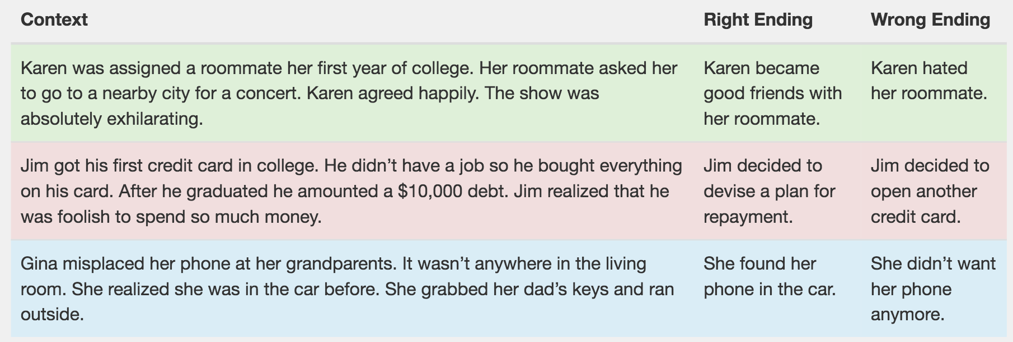
Task
Story Cloze Test (story understanding in everyday life)
Reason the right story ending using implicit commonsense knowledge rather than explicit matching or entailment, etc.
http://cs.rochester.edu/nlp/rocstories/

Slide 55
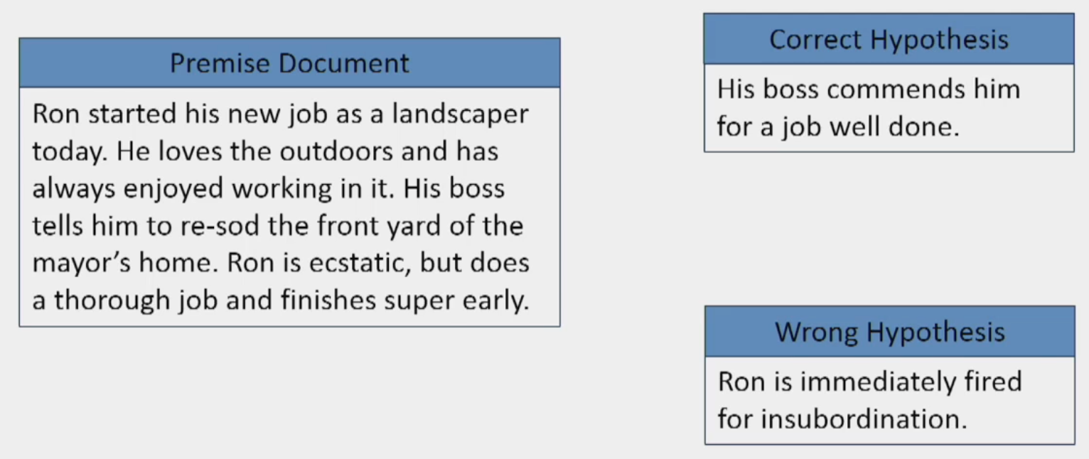
Example & Intuition
https://vimeo.com/238235420
Notes:
How can we solve this problem systematically

Slide 56
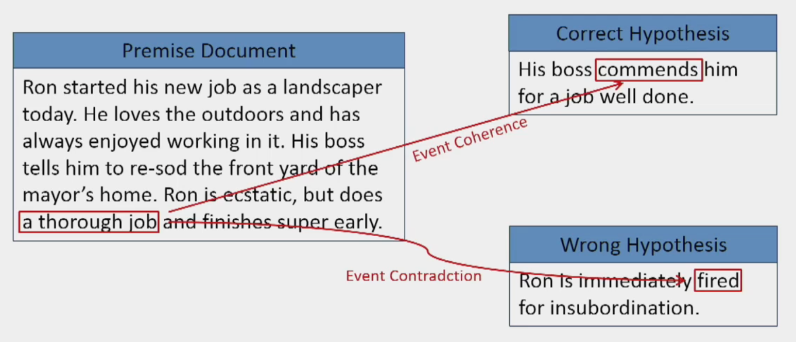
Example & Intuition
https://vimeo.com/238235420

Slide 57
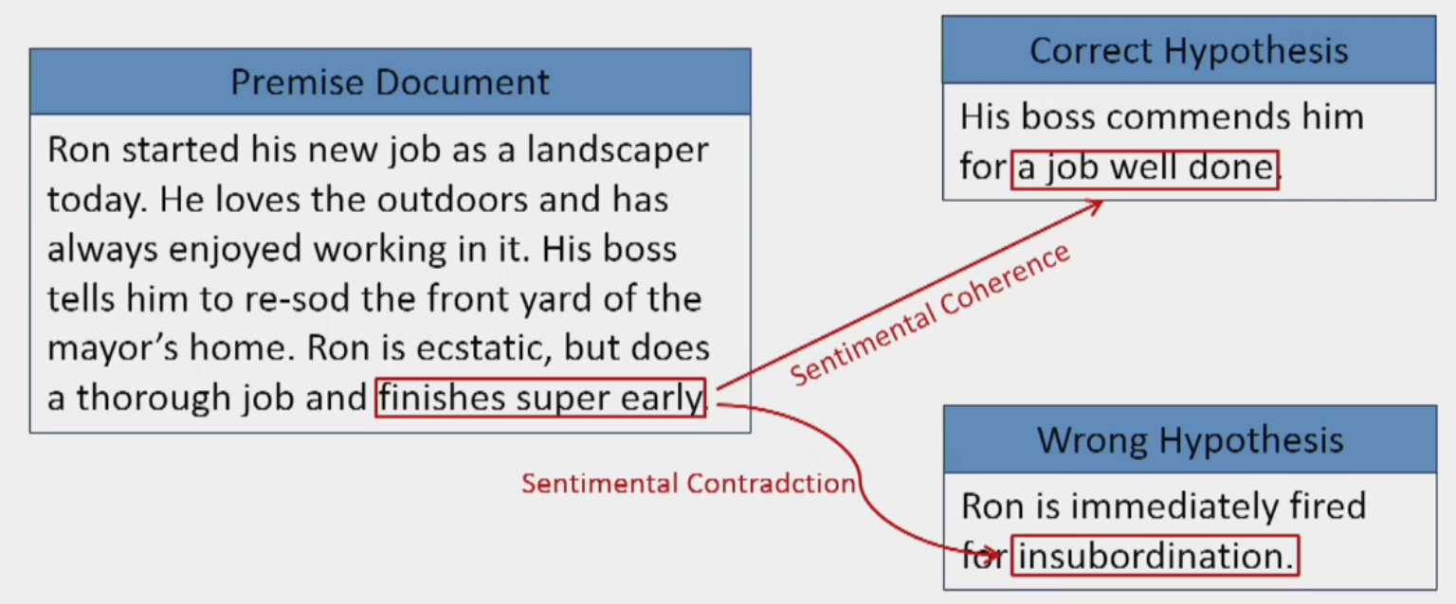
Example & Intuition
https://vimeo.com/238235420

Slide 58
Method overview
Step1. Mine the key commonsense knowledge for story understanding
X →^{f} Y : s
element Y can be inferred from element X under relation f, with an inference cost s
Step2. Machine comprehension via commonsense reasoning.
Use the commonsense knowledge to evaluate the “cost” of going from the premise text to each story ending

Slide 59
Key commonsense knowledge for discourse
For the types of relations f, we consider
Event narrative knowledge: temporal and causal relations between events
Entity relation knowledge: semantic relations between entities
Sentiment knowledge: sentiment coherence between elements

Slide 60
Key commonsense knowledge for discourse
Event narrative knowledge: temporal and causal relations between events
E.g. “Mary went to a restaurant” ⇒ “She ordered some foods”
Methods to mine:
Ordered PMI (Rudinger et al., 2015)
Skip-gram (Mikolov et al., 2013)

Slide 61
Key commonsense knowledge for discourse
Entity relation knowledge: semantic relations between entities
Coreference: e.g. “Starbucks” ⇒ “coffee shop”, “puppy” ⇒ “dog”
Method to mine: Wordnet (Kilgarriff and Fellbaum, 2000)
Associative: e.g. “Starbucks” ⇒ “latte”
Method to mine: Wikipedia linking (Milne and Witten, 2008)
Sentiment knowledge: sentiment coherence between elements
Extract from SentiWordnet (Baccianella et al., 2010)
E.g. “good” → “happy” : −1
E.g. “perfect” → “sad” : 1
E.g. “young” → “happy” : 0

Slide 62
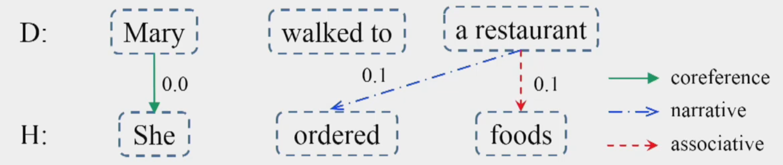
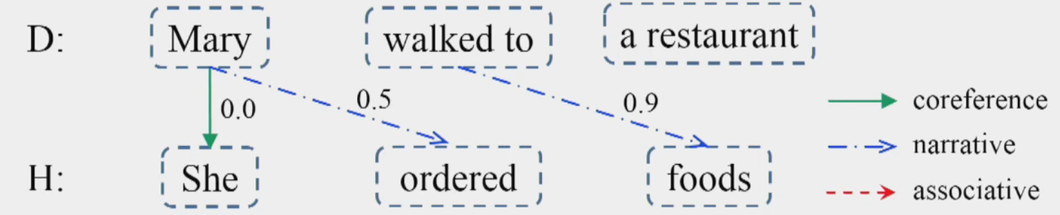
Inference from premise doc to hypothesis
Higher probability
Lower probability

Slide 63
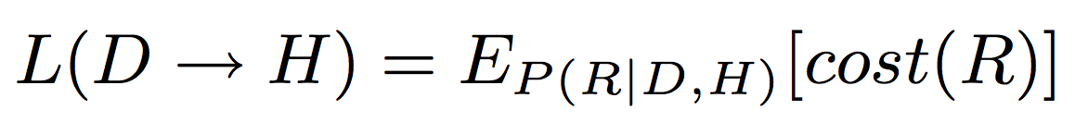
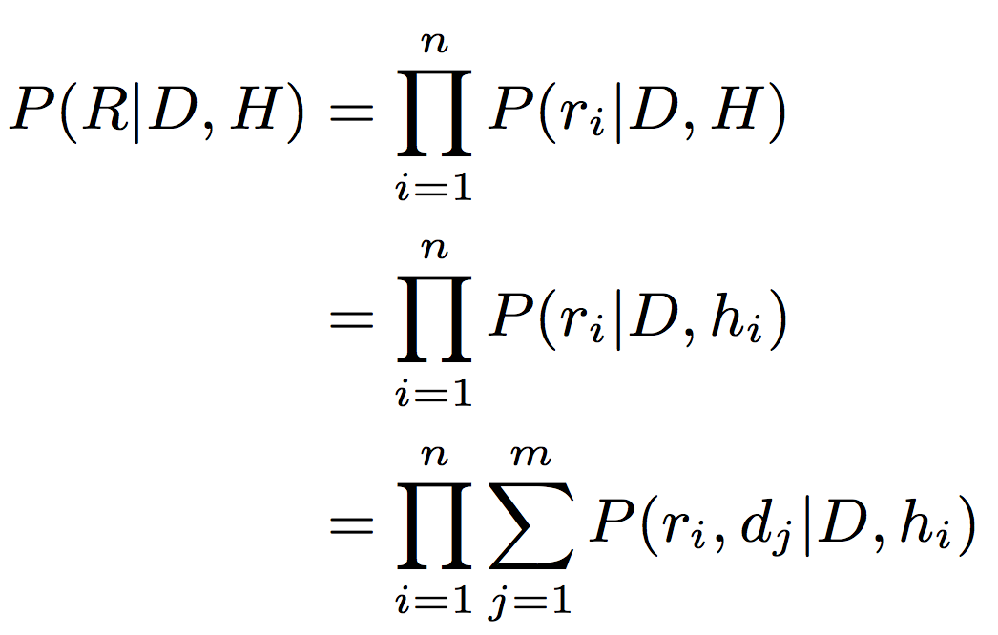
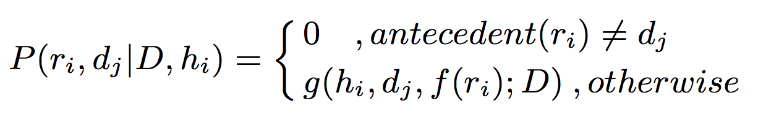


Cost from premise doc to hypothesis
The overall cost from the premise document (D) to hypothesis (H) is
where R is the possible inference pattern
Parameterization detail

Slide 64



Results

Slide 65
Discussion
I think that this model is interpretable:
It makes intuitive sense to consider the cost of inference between possible elements. Not like binary edges in traditional commonsense knowledge graph.
The contribution of each type of knowledge (event, entity, sentiment) is clear
Any thoughts on this paper’s method?

Slide 66
Conclusion
We have covered
Learning physical commonsense (e.g. size, weight, speed, action-effect)
Application to vision and robotics
Learning social commonsense (e.g. intent, reaction)
Application to narrative understanding and human-like dialogue
Narrative understanding (e.g. using event, entity, sentiment commonsense)

Slide 67


Other cutting-edge research
Grounded commonsense:
Swag: A Large-Scale Adversarial Dataset for Grounded Commonsense Inference
Application to other tasks:
Entity Commonsense Representation for Neural Abstractive Summarization

Slide 68
Discussion for class
Future directions
Other important commonsense knowledge that machine should learn, or that needs more research?
Other unsolved challenges?
Better way to tackle the problems we covered today?
How to incorporate commonsense knowledge into reasoning?
Other application of commonsense knowledge?
Is it possible to integrate language/vision/robotics techniques and learn commonsense?

Slide 69
References (other than images)
Talks:
Gerard de Melo, Niket Tandon and Aparna S. Varde, “Commonsense for Machine Intelligence: Text to Knowledge and Knowledge to Text”, Tutorial at ACM CIKM 2017.
Dan Roth, “Natural Language Understanding with Common Sense Reasoning,” Microsoft Research Faculty Summit 2015.
Yejin Choi, “From Naive Physics to Connotation: Modeling Commonsense in Frame Semantics”, Talk at ACL 2017.
Papers:
ConceptNet — a practical commonsense reasoning tool-kit
Verb Physics: Relative Physical Knowledge of Actions and Objects
What Action Causes This? Towards Naive Physical Action-Effect Prediction
Event2Mind: Commonsense Inference on Events, Intents, and Reactions
Reasoning with Heterogeneous Knowledge for Commonsense Machine Comprehension
A Corpus and Cloze Evaluation for Deeper Understanding of Commonsense Stories

Slide 70
Thanks!
Q&A

